Slide 1
Learning a foreign language in the US
Yi Wang
CRE 101 (12326)

Slide 2
Introduction------My Story
I had a very bad experience of learning English in China. The English class in China always concentrates on grammar and reading, so after many years of learning, I still can’t speak English frequently. However, after I came to the US, my English was improved dramatically. I think that is the difference between learning a foreign language and a second language (foreign language refers to the language is not dominantly used in the country, where you are learning).

Slide 3
Introduction------Issue
Usually, in the US, people pay more attention to learning English as a second language, while much fewer people look into American students learning a foreign language. That is why I am interested in this topic. As my first language is Chinese, I choose to serve in the Confucius Institution of ASU. I believe that to know more about the learning difficulties, a language classroom is the best place to go because various learning difficulties are reflected on the teaching and learning process. I hope I can give helps in some Chinese summer camps or classes, while at the same time, collect first hand data about what the difficulties that American students face when they are learning Chinese.

Slide 4
Introduction------Initial Ideas
Whether the Chinese class in the US has the same problems like the English class in China does?
What are the special challenges that the American Chinese learners face?
How first language acquisition and second language learning can enlighten and improve the foreign language class in the US?

Slide 5
Introduction------Hypotheses
American Chinese learners will have the same problems as other people learning a foreign language in which country the language is not dominantly used. The problems
include: A. Lack of language environment B. Problems of Language class a. Gap between class and real life b. Focus on input skills (listening & reading) over output skills (speaking & writing) c. First language is allowed to use (comparing to learning English as a second language in the US) d. learning the language differently from native speakers do (inspired by observation) ⅰ learning two kinds of Chinese writings at the same time
ⅱ learning grammar
American Chinese learners may be have unique challenge, such as: A. Motivation might be compromised by the power of their native language, English. B. Motivation also might be related to the international status of the foreign language they learn.

Slide 6
Current Situation-------Statistics
The US
Other countries
Less than 10 percent of Americans can speak anything other than their native tongue fluently (npr.org)
More U.S. students study Sign Language than Chinese
Only 500 U.S. high school students study Arabic
2/3 of all U.S. high school students graduate without studying a language
92 percent of all U.S. college students never take a foreign language class (swamppolitics.com)
About half of all European citizens speak another language, and eight out of ten students are conversational in at least one foreign language (npr.org)
Upwards of 350 million people, a number greater than the entire American population ,are learning English in China and about ten million people within the mainland actually speak it fluently and use it often (quora.com)

Slide 7
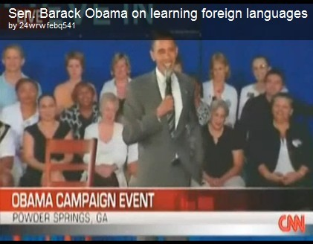
Problem Acknowledgement------Speech Analysis
Obama first acknowledged the idea (refutation) that immigrants should learn English, which was held by opponents, who object foreign language learning and then pointed out the logic fallacy (false cause) they made: immigrants need to lean English doesn’t mean Americans don’t need to learn foreign languages. He used vivid examples to support his ideas and used “should” through his whole speech to call on the audience’s supports. It looks like the speech very successful.

Slide 8
Problem Acknowledgement------Speech Analysis
“I don't speak a foreign language.
It's embarrassing!” (cbsnews.com)
------ Obama
When talking about the importance of teaching foreign languages in schools, President Obama used “embarrassing” to describe the fact that he can’t speak a foreign language, which may implies:
#1 As a person growing up overseas, he feels embarrassing to not speak a foreign language.
#2 Speaking a foreign language is a necessary skill for a president, but he can’t.
#3 Comparing to other countries’ people, who can speak more than one language, American people should be embarrassing for they can’t.

Slide 9
Problem Acknowledgement------Editorial Analysis
“Despite our polyglot origins, less than 10 percent of Americans can speak anything other than their native tongue fluently, and English speakers are notoriously monolingual.”(npr.org)
The author used “polyglot origins” to contrast the fact that very few Americans can speak languages other than English. Such irony easily pointed out the embarrassing situation of Americans.
The author used a very strong word “notoriously,” which implied that Americans can only speak their native language is a long time problem. Everyone knows it.

Slide 10
Problem Acknowledgement------Editorial Analysis
“I'm at least smart enough to envy people who speak more than one language, knowing that they have a wider lens than I do through which to view the world.” (swamppolitics.com)
“At least” and “enough” implied that the author didn’t really think himself or herself smart, but sarcastically say that those people, who don’t realize the advantages of speaking more than one language, are stupid.
“Wider lens” is a great metaphor to express that knowing more languages can widen people’s horizon.

Slide 11
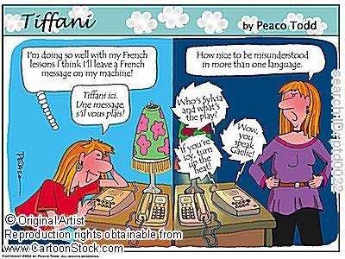
Problems Reflected on Cartoon
"How nice to be misunderstood in more than one language!"
“Nice” is a kind of sarcasm. Obviously, the woman is upset, but it refers to how amazing being misunderstood in so many ways when she speaks a foreign language.
This cartoon nicely reflects the embarrassment of learning a second language: Although you did very well in a language class, when it comes to the real life usage, you always have a long way to go!

Slide 12
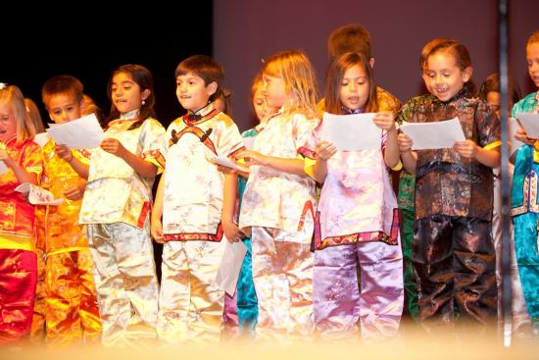
Problems Reflected on Photograph
Children are reading Chinese ancient poems.
Those children, who are wearing Chinese traditional costumes look very happy. I am not sure how much they understand what they are reading and I don’t know how correct their pronunciation is, but one thing I am sure: they are enjoying Chinese. Sometimes, when we focus too much on language teaching and learning, we forget the fun part of learning a language: feeling the beauty and culture that associated to it.

Slide 13
Problems Reflected on Advertisements
This series of advertisements were made by American Council on the Teaching of Foreign Languages to appeal children to learn a foreign language.
“Foreign language education spells success.”
It is a nice advertisement slogan, but it oversimplified the factors of success. Foreign language can increase the possibility of success, but not a guarantee.
“Give him the world.”
What an exciting slogan! But like the left one, it exagerated the benefits of learning a foreign language. It actually means to give children more opportunities to access to the world.

Slide 14
Problems Reflected on Advertisements
“Learning a foreign language should be elementary.”
This is a quite smart advertisement slogan. “Elementary” is a pun. On one hand, it means that learning a foreign language should be a fundamental part of children’s education; on the other hand, it implies that learning a foreign language should be start from children.

Slide 15
Famous Theory Analysis
The famous language acquisition theory of Professor Stephen Krashen.
Dr. Krashen's theory has very huge influence in field of language teaching and learning. He challenged the traditional grammar based language teaching method and proposed that language is learned in the same way, no matter native language or second/foreign language. On the good side, he encouraged teachers to focus on communication rather than grammar, which was a cure for the disadvantages of traditional language class. However, on the bad side, many teachers over believed in Krashen's theory, thoroughly negating the values of language class and grammar teaching.

Slide 16
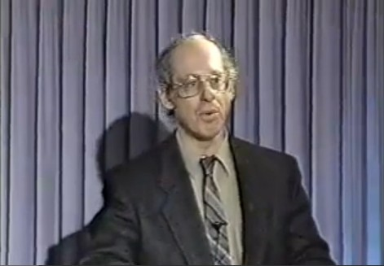
Famous Theory Analysis
Stephen Krashen on Language Acquisition

Slide 17
Famous Theory Analysis
There was one thing Krashen ignored. That was the differences between children and adults. During his speech, he used children as example to explain how "comprehensive input" and "low anxiety" was the only way for them to learn a language. But, how about adults? Do adults learn language in the same way? Obviously, they don't. As far as we know that, children learn languages easier and faster, because of the "language acquisition device," which Krashen mentioned in his speech. However, when people reach certain age, the LAD is not there anymore. That explains why adults learning languages is much harder. Adults need language classes to help them "learn" languages intentionally, while children can "acquire" languages through extensive exposure to those languages. Therefore, people don't learn languages in the same. Krashen was hasty generalized about his conclusion. As for the "digest" example Krashen used, maybe people digest food in the same way, but what they can eat is different. Children and adults eat different food, so does everyone. Thus the metaphor Krashen used was not appropriate.

Slide 18
Poll
Based on the hypotheses in Slide 5, I designed a 7-question survey.
Target Population:
College Students
Group size:
21
#1 How long have you been learning Chinese?
#2 Why do you learn Chinese?
#3 Do you think your expectation of Chinese learning sometimes is compromised, due to your native language, English, is the most powerful language in the world?
#4 Do you think the Chinese teacher can speak English (or you are allowed to use your native language in the Chinese class) is a good thing or bad thing?
#5 Which language skill is the most difficult part for you?
#6 Do you feel confused by learning traditional Chinese and simplified Chinese at the same time?
#7 Which aspect hinders you from learning Chinese in the US the most?

Slide 19
Poll Results
#2 Reason of learning
43% useful for future
28.5% love Chinese
28.5% both
#3 English power impact
14% Yes
86% No
#1 Learning duration: Varied from 1 month to 4 years.
#7 The biggest obstacle
86% lack of language environment
14% gap between textbook and real life
#6 Confused about two writings
57% Yes
43% No
#4 Using first language
100% Support
#5 The hardest skill
43% speaking
14% listening
14% writing
29% both speaking and listening

Slide 20
The implications of Poll Results
Corrected hypotheses
Strengthened hypotheses
The Chinese class in the US has the same problems as other foreign language class, as the two primary difficulties that the participants chose are lacking of language environment and the big gap between textbook and real life, and most of them think listening and speaking are the hardest parts to learn.
100% students think that using their first language in the Chinese class is helpful, so the immersion method like English classes adopted in the US is not the way to help those students learn Chinese.
86% students believe that the power of English doesn’t hinder them from learning another language and 43% participants learn Chinese for future use. Therefore, lack of motivation can be rule out as a major challenge for American students learning Chinese
Only half participants feel confused about learning two Chinese writings at the same time implies that force them to stick to one writing like native speakers do may not be a good way.
Suggestions:
#1 more listening and speaking practices need to be added
#2 one to one practical training
#3 authentic learning materials adapted from real life

Slide 21
Validation and Limitation of Poll
Since the learning duration of participants varies from 1month to 4 years, the results can represent Chinese learners from different learning stages.
As the class I observed is an intensive summer class, the students who took it usually have very high motivation and passion in learning Chinese. Thus, if I carry out the survey to regular class students, results may be different.

Slide 22
Reference
http://www.cbsnews.com/8301-502443_162-4254480-502443.html
http://www.npr.org/templates/transcript/transcript.php?storyId=4954183
http://www.quora.com/China/How-many-people-in-China-can-speak-English
http://www.swamppolitics.com/news/politics/blog/2006/05/what_will_make_americans_learn.html

